Slide 1

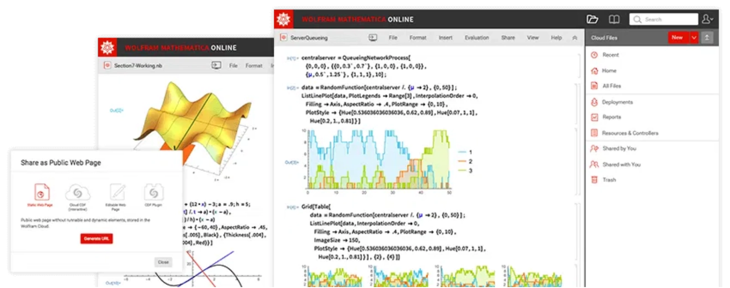
Introduction to Wolfram/Mathematica
Wolfram Mathematica
is a powerful computational software system used for mathematical computing, data analysis, visualization, and programming.
As a student at the
University of Aberdeen
, you have free access to Wolfram products through the university license.
This guide will walk you through the complete process of obtaining, installing, and activating your Wolfram/Mathematica license.
The latest version is now called
Wolfram
(formerly Mathematica) for versions 14.1 and higher.
1

Slide 2

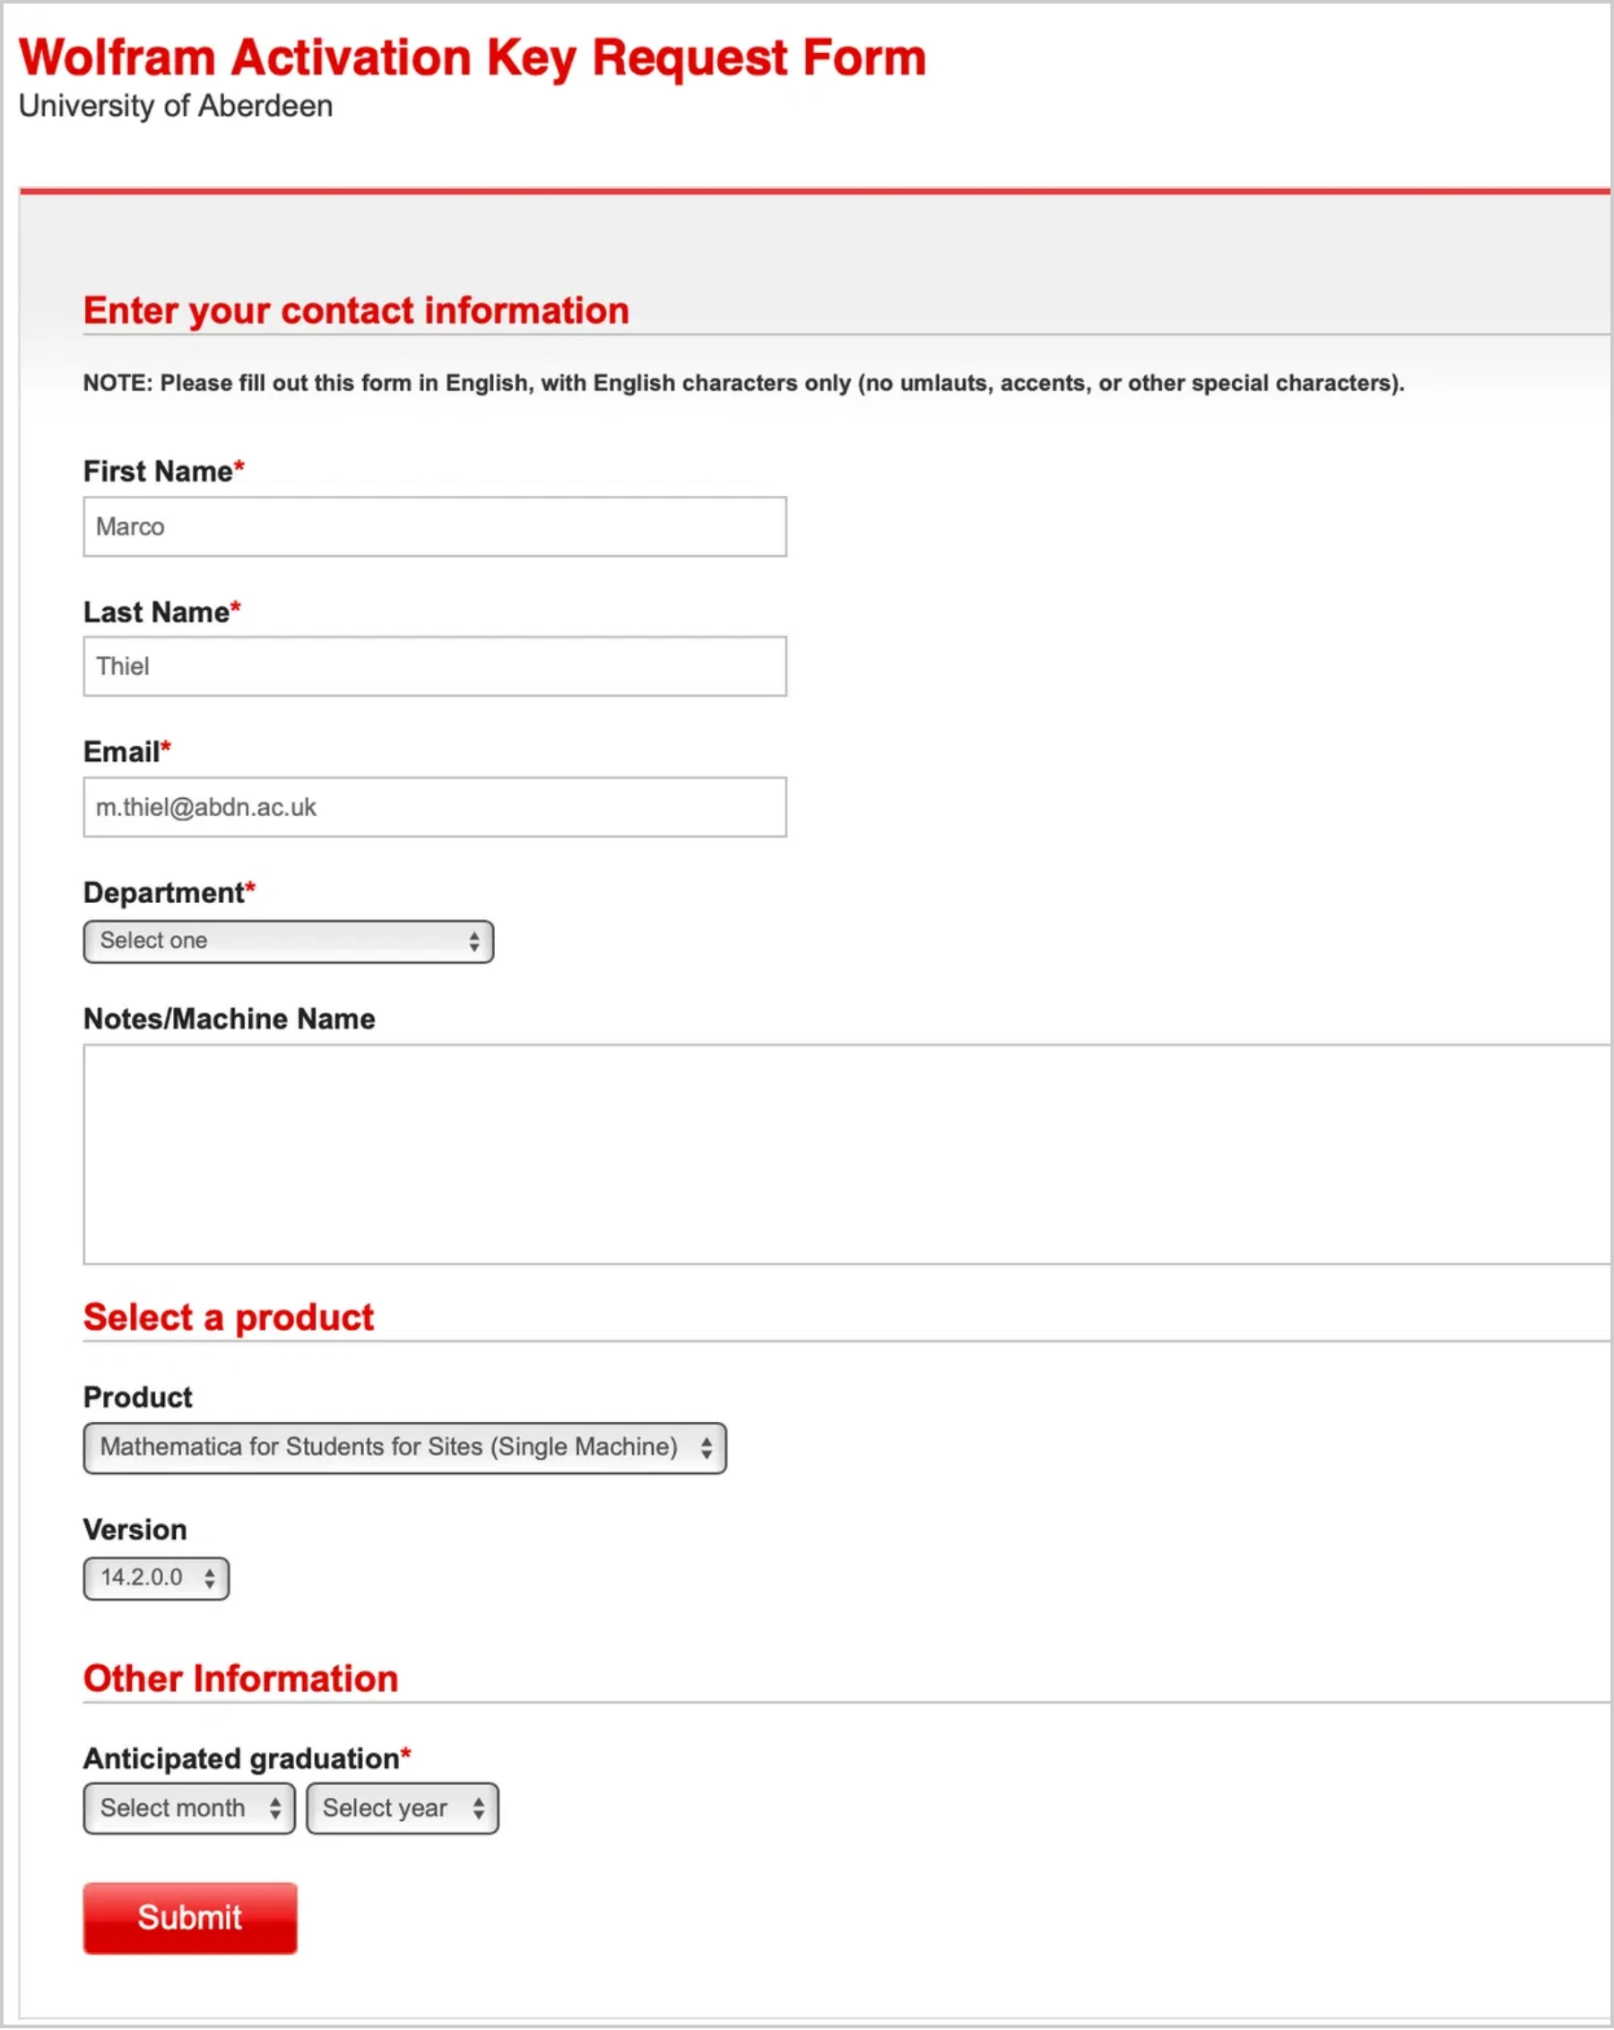
License Eligibility & Overview
Who is eligible?
All enrolled students in the course at the University of Aberdeen.
License includes:
Full version of Wolfram/Mathematica software
Access to Wolfram Language
Documentation and learning resources
License duration:
Initial:
Two-week temporary license
After validation:
Extended for the academic year
Number of installations:
Up to
two licenses
per student
For additional licenses, contact your instructor
2

Slide 3

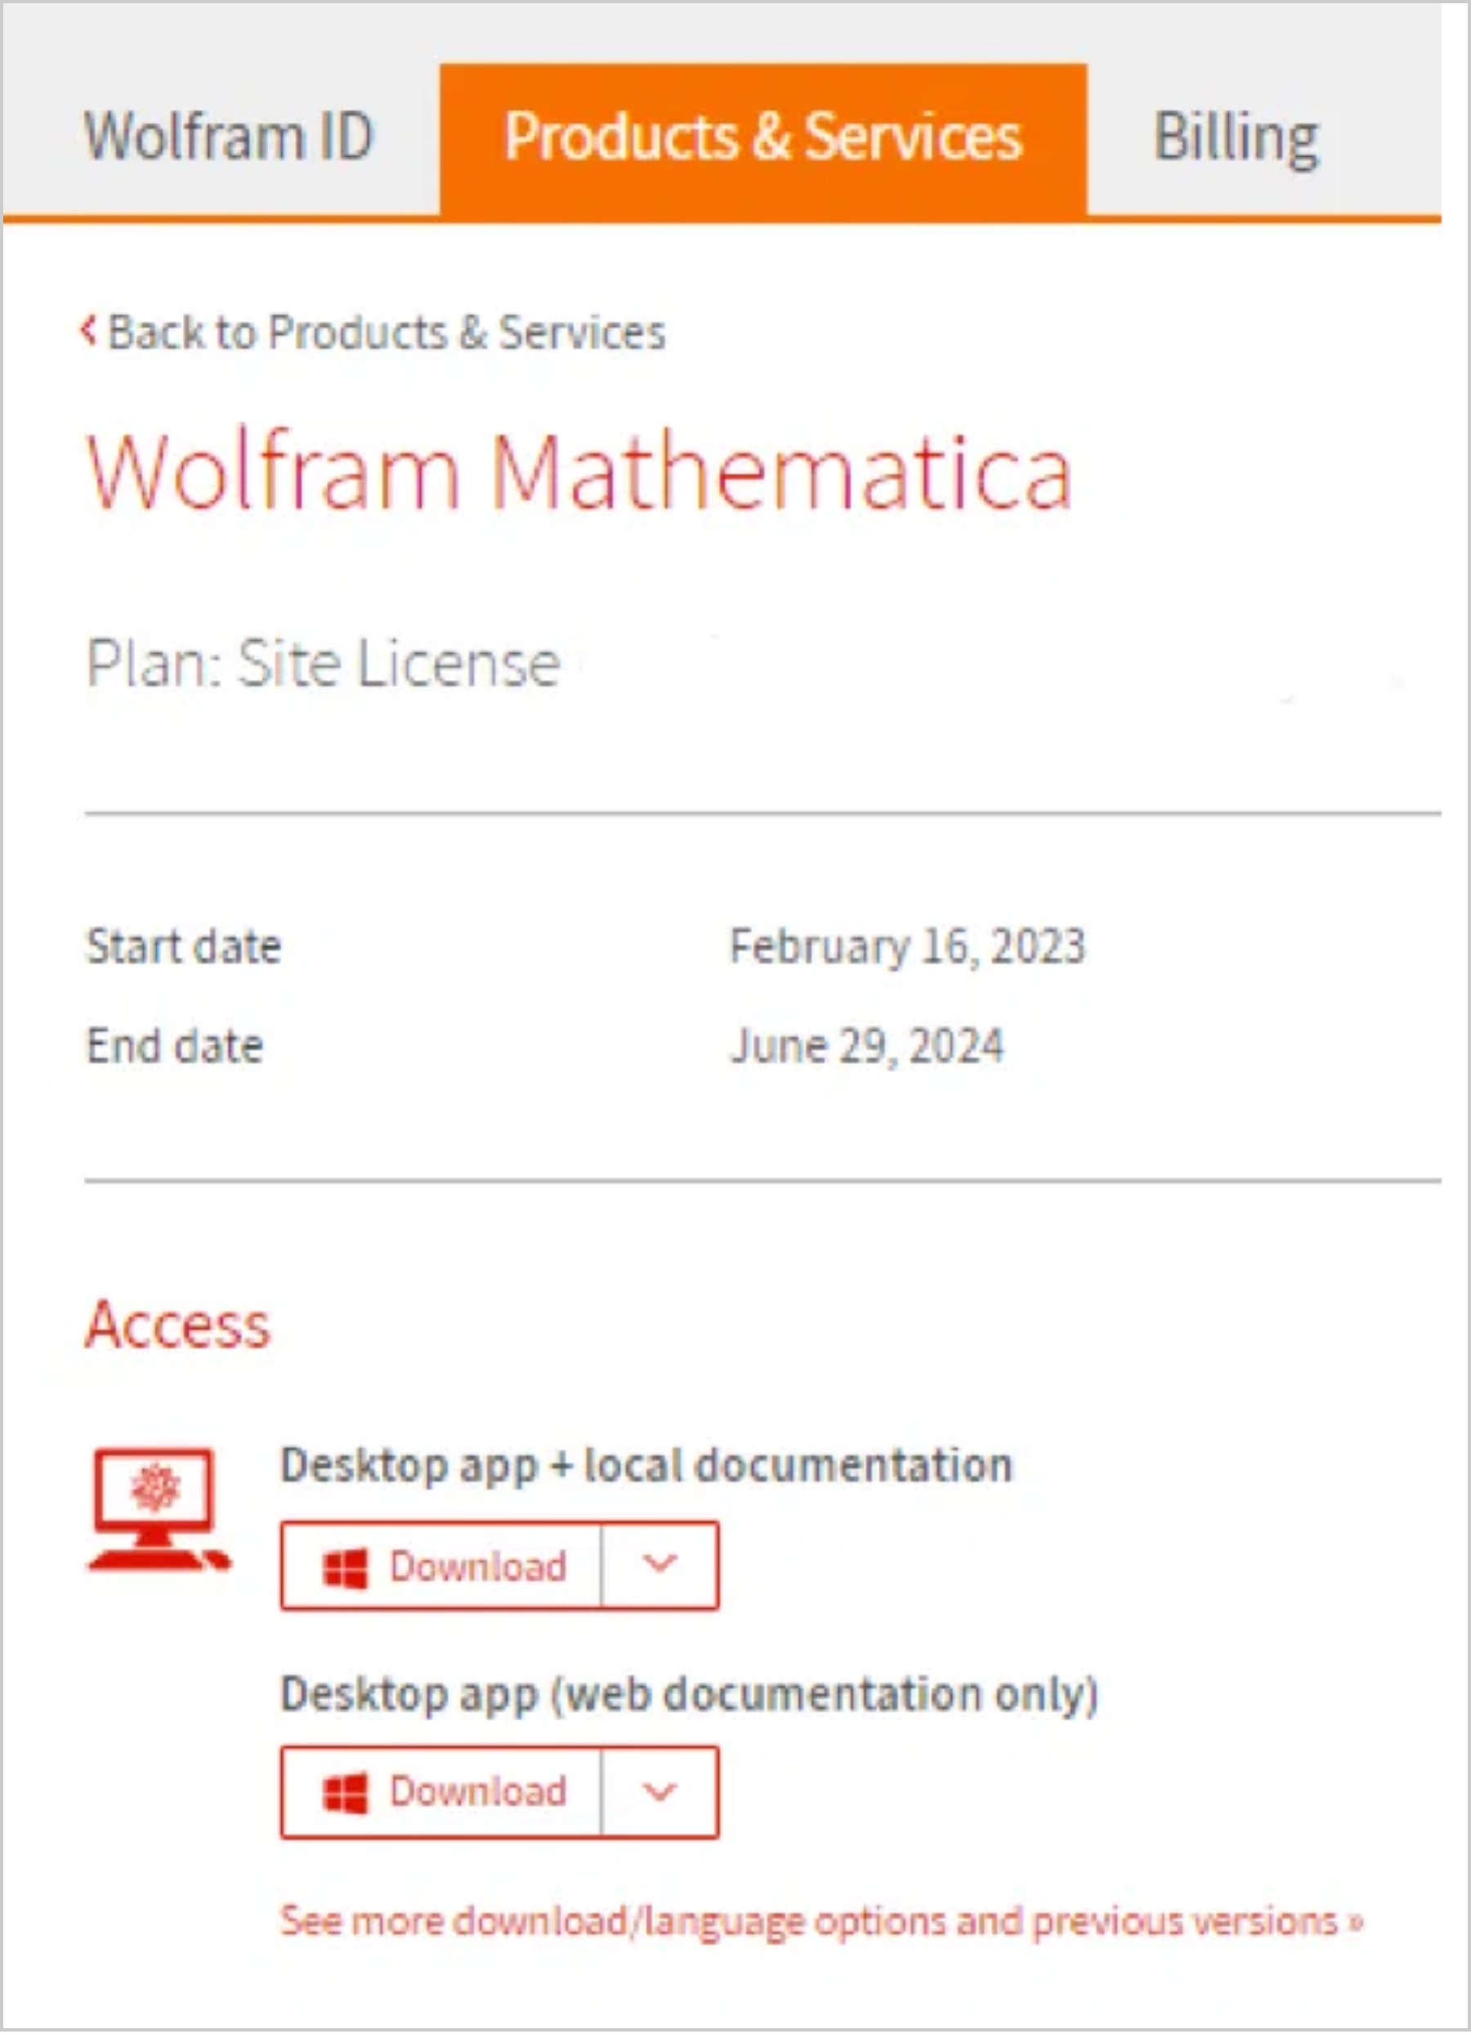
Accessing the Activation Key Request Form
1
Find the Link
The link to the Wolfram Activation Key Request Form is provided in your course materials.
Look for:
"Wolfram Activation Key Request"
2
Access the Form
Click on the link to open the Wolfram Activation Key Request Form in your web browser.
3
Important Note
You
must use your University email address
when
filling out this form to verify your student status.
3

Slide 4

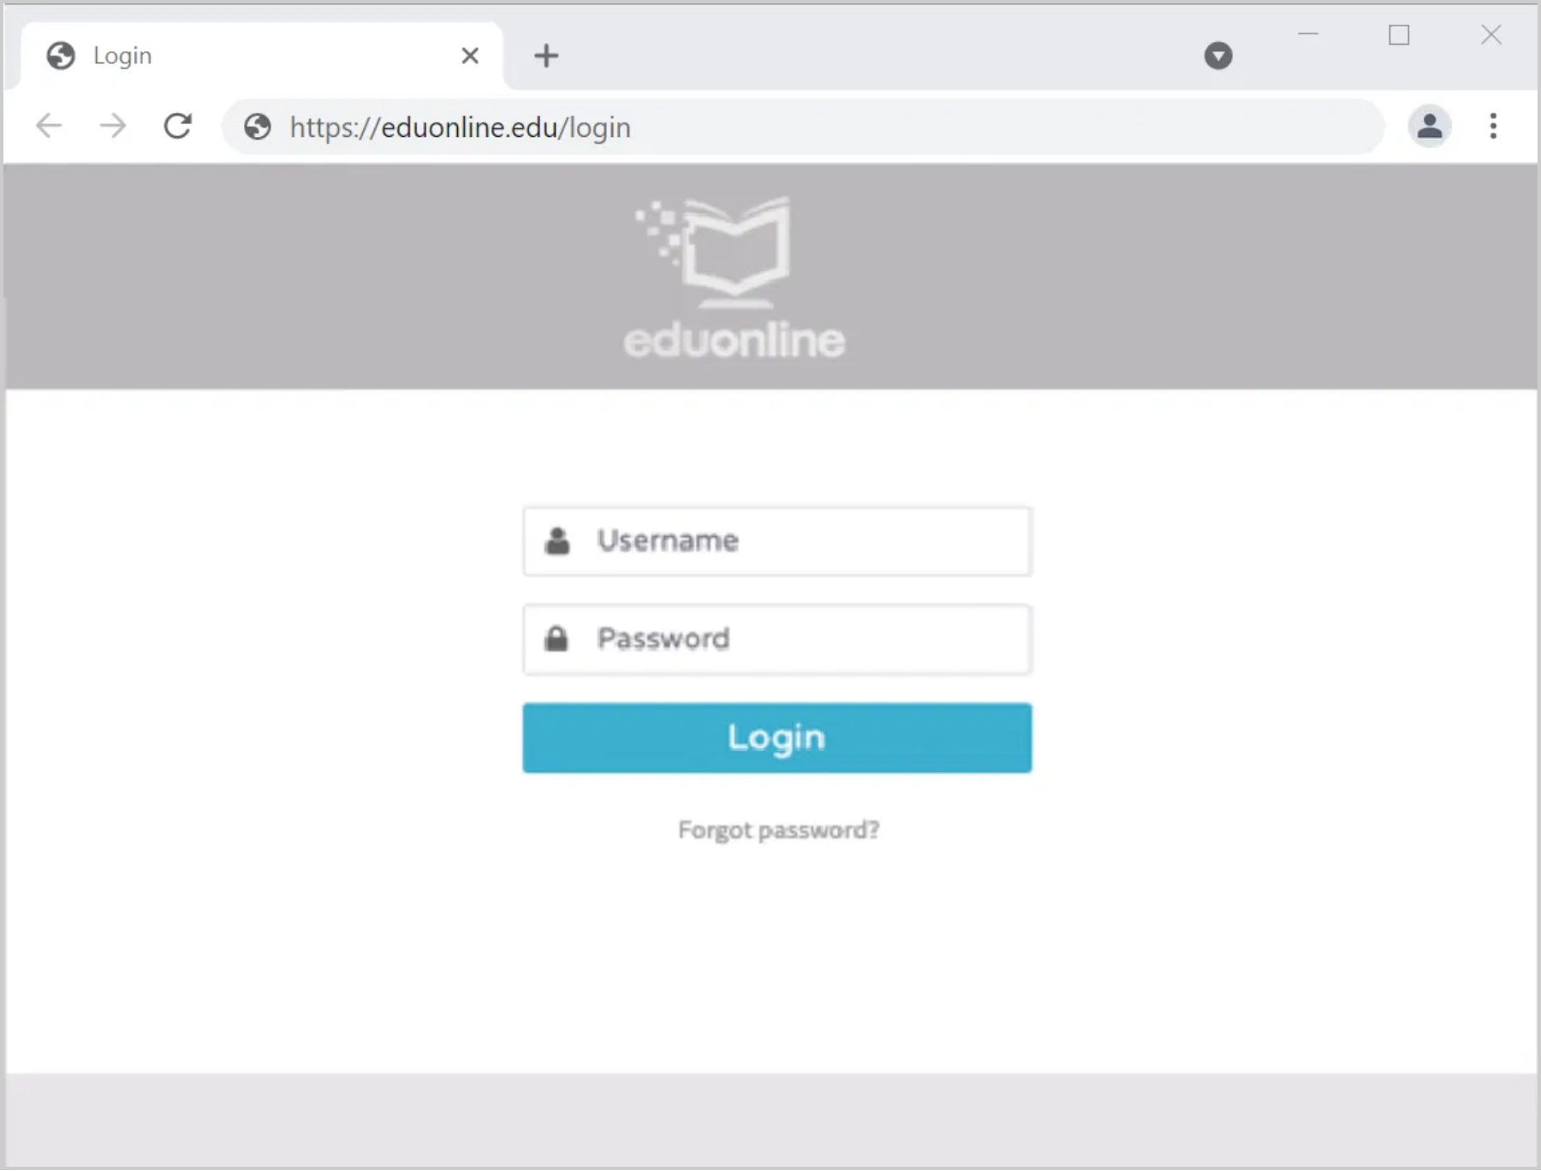
Completing the Activation Key Request Form
Fill out all required fields (marked with *) in the form:
First Name*:
Your first/given name
Last Name*:
Your surname/family name
Email*:
Your University email address
(e.g.,
s01ab23@abdn.ac.uk)
Department*:
Select your department from the
dropdown menu
Product*:
"Mathematica for Students for Sites (Single
Machine)"
Version*:
Select the latest version available
Graduation*:
Select your anticipated graduation month
and year
After completing all fields, click the
Submit
button.
4

Slide 5

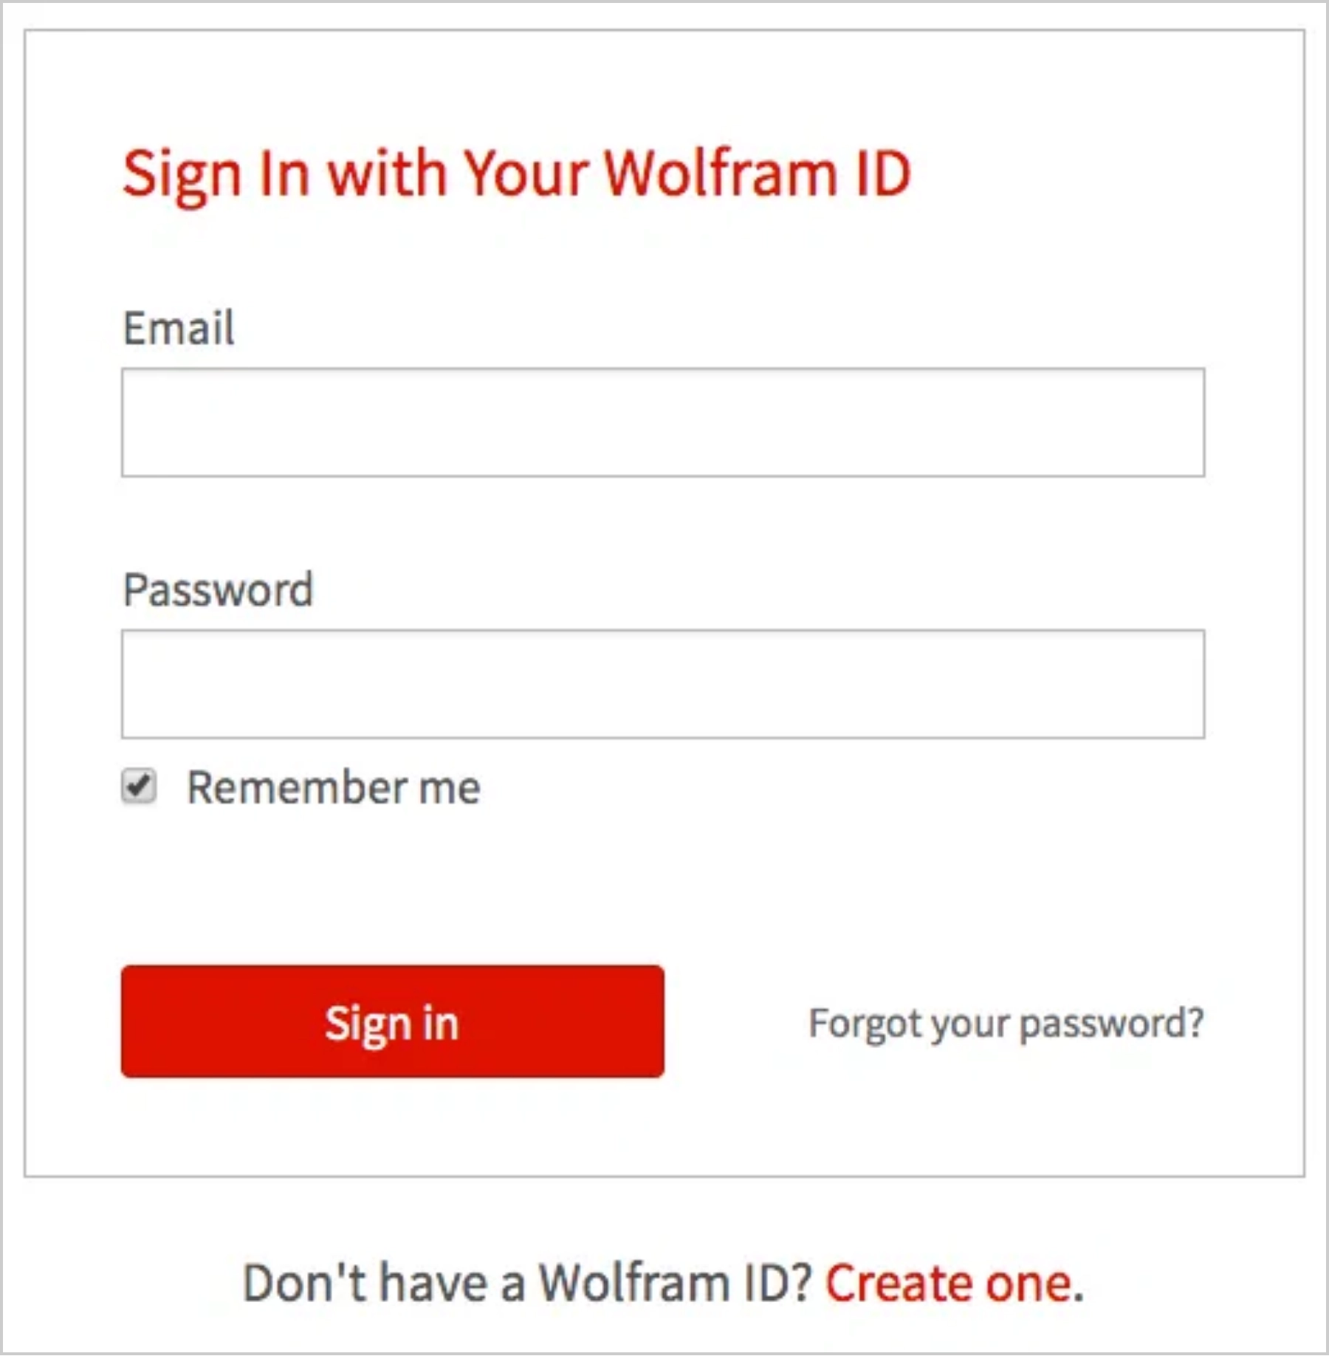

Creating a Wolfram ID
1
Create New Account
After submitting the form, create a Wolfram ID if you don't have one.
Click
"Create one"
when prompted to sign in.
2
Enter Your Details
Use your
University email address
as your Wolfram ID.
Create a secure password and fill in required information.
3
Verify Your Email
Check your university email for a verification message.
Click the verification link or enter the code to complete setup.
Important Note
Your Wolfram ID is
separate
from your University credentials. Wolfram is an independent company and does not have
access to your university login information.
5

Slide 6

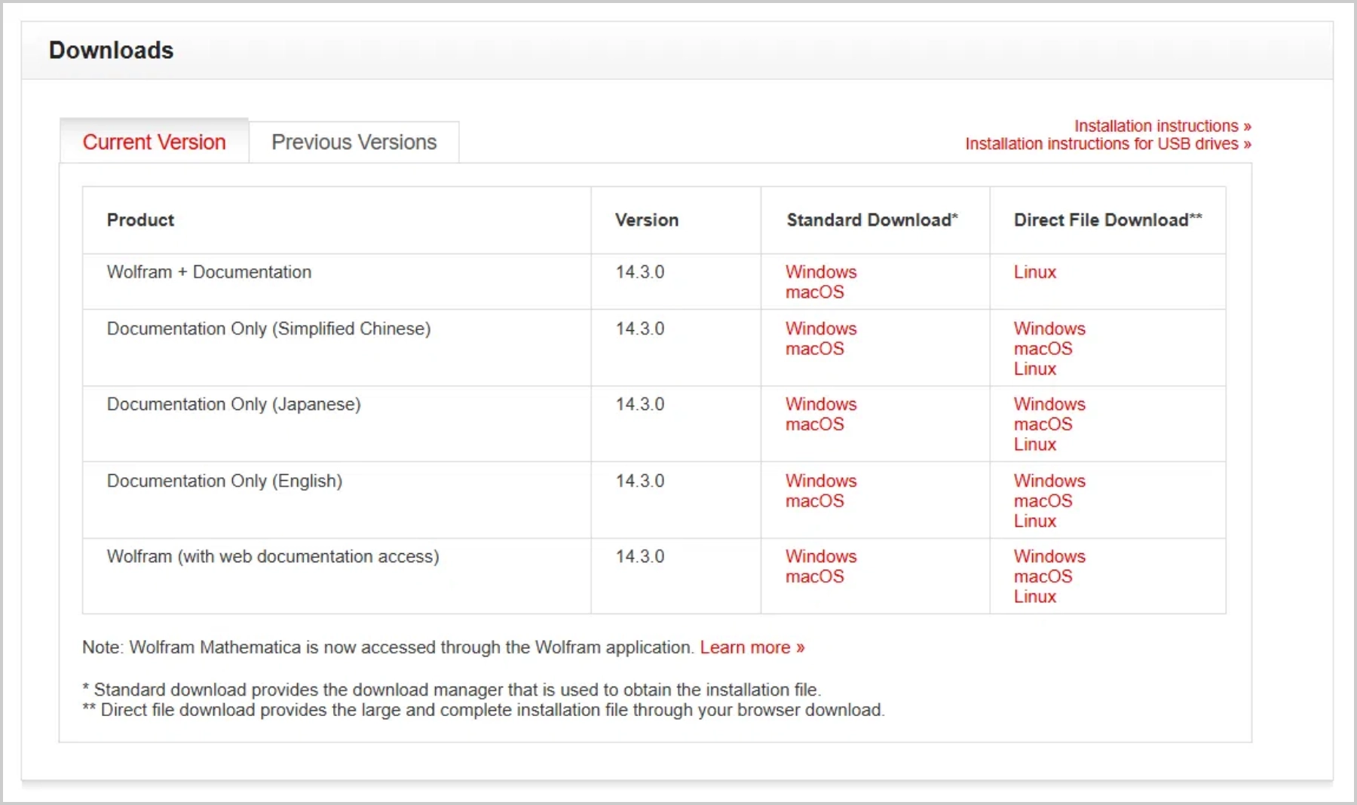
Downloading the Installer
1
Access Download Page
After receiving your activation key by email, log in to your Wolfram Account or Wolfram User Portal.
Go to the
Products & Services
tab.
2
Select Your Version
Choose the correct version for your operating system:
Windows
macOS (Apple Silicon or Intel)
Linux
3
Download Manager
Use the
Wolfram Download Manager
for the most
reliable installation experience.
This will download both the core product and documentation.
6

Slide 7

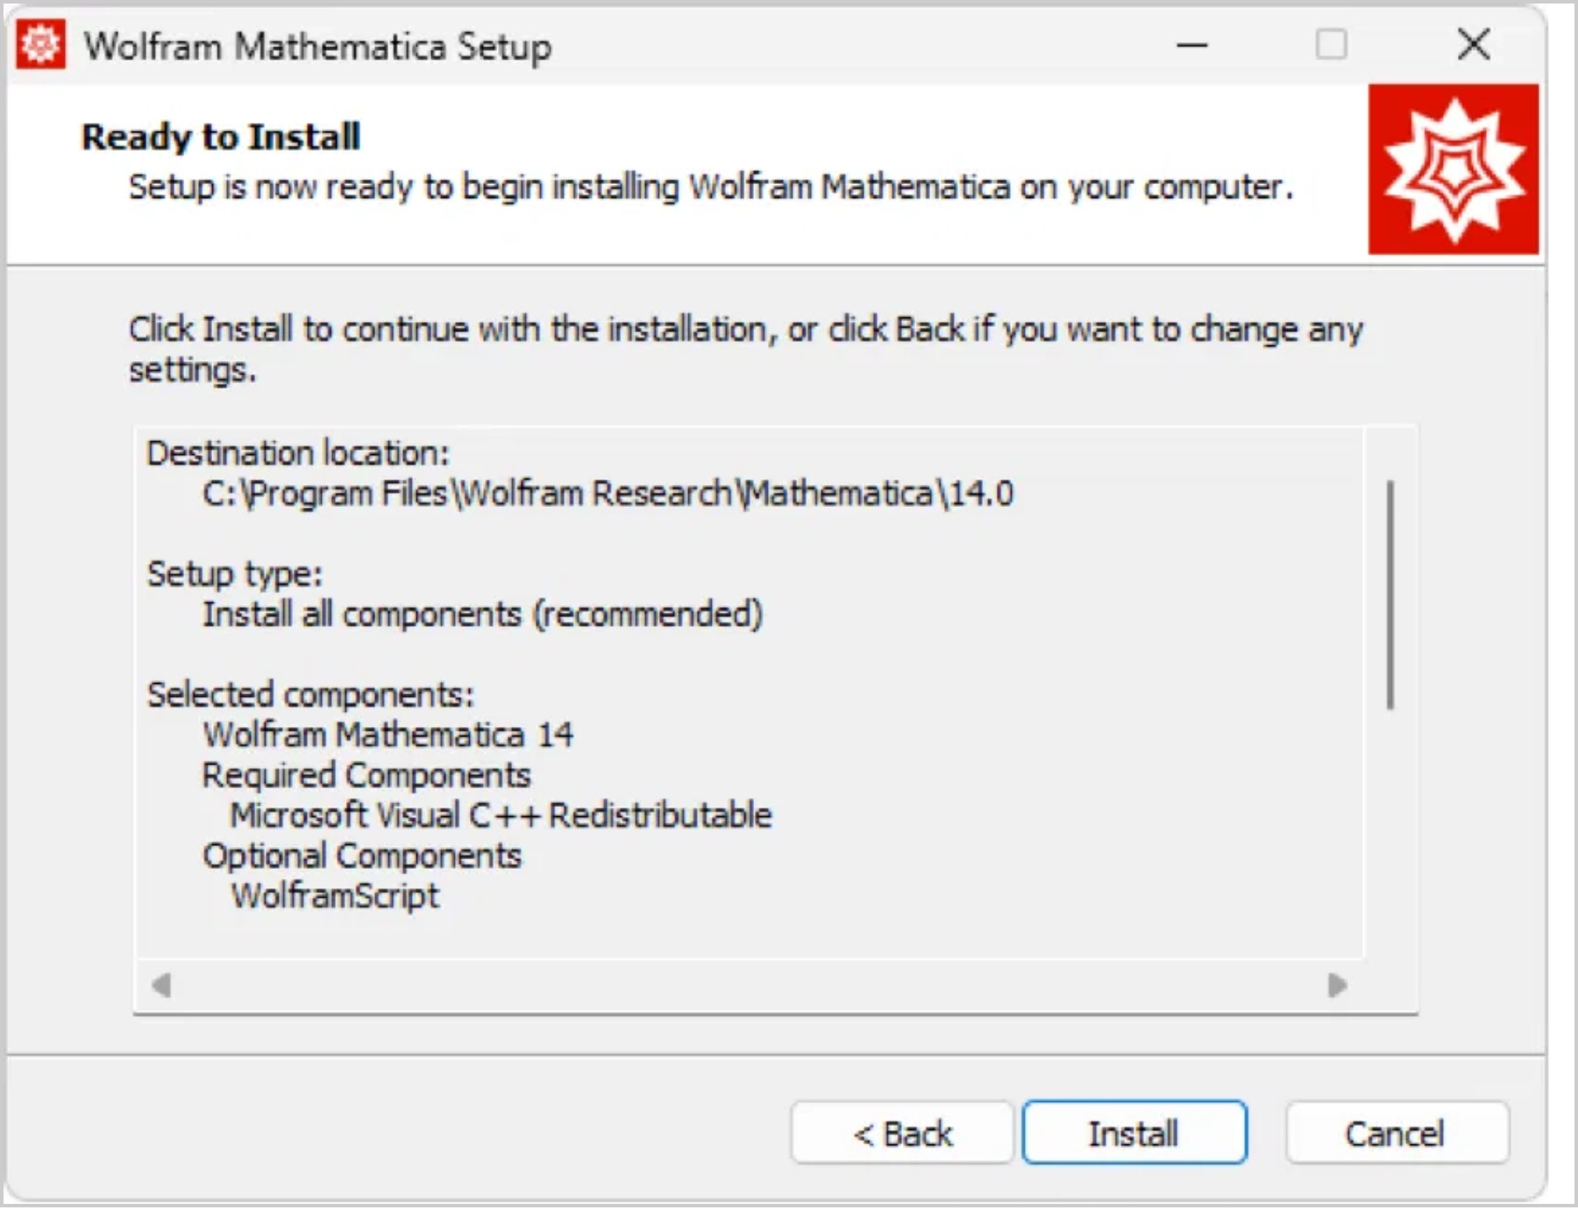
Installing Wolfram/Mathematica
1
Run the Installer
Double-click the downloaded installer file to begin the installation process.
For Windows:
.exe file
For Mac:
.dmg file
For Linux: Run the
.sh script
in terminal
2
Installation Options
Follow the on-screen prompts and select the recommended options:
Default installation location
Include wolframscript (recommended)
Create desktop shortcuts
3
Complete Installation
Click "Install" to begin the installation process.
When installation is complete, click "Finish" to launch Wolfram/Mathematica.
7

Slide 8

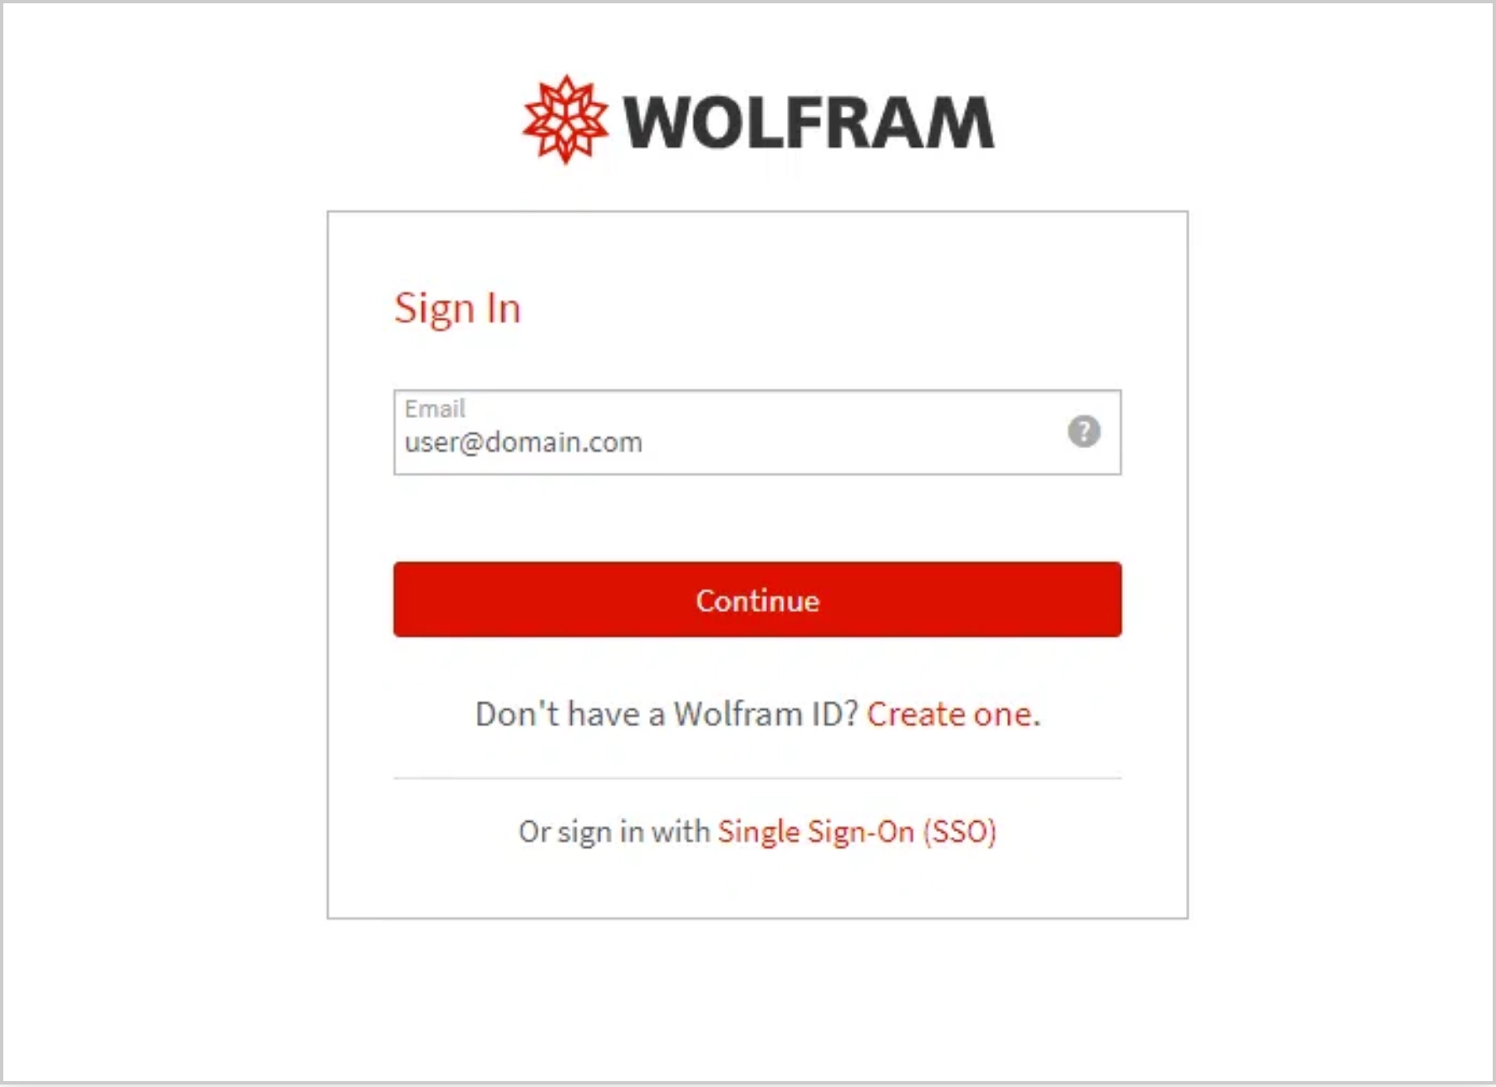


Activating Your License
After installation, you'll need to activate your Wolfram/Mathematica license. There are several methods available:
Online Activation through Sign In
Recommended method
- Sign in with your Wolfram ID
and password
For university licenses, select the SSO (Single Sign-On) option if available
Online Activation with Key
Enter the activation key you received via email after submitting the request form
After activation, you'll need to accept the Wolfram License Agreement to complete the setup process.
8

Slide 9





Temporary License & Validation
Initial Temporary License
License Validation Timeline
After completing the activation process, you will receive
a
two-week temporary license
.
This allows you to begin using Wolfram/Mathematica immediately while your student status is being verified.
Day 1
Within 2
After Validation
Day 1-2
Initial
Weeks
Permanent
Activation
Request
Validation
License
Instructor Validation
Important Note
During the two-week period, your instructor will
confirm your enrollment
If your license is not validated within two weeks, the software will stop working. Contact your instructor if you experience any issues with validation.
in the course.
No action is required on your part for this step.
Permanent License
After validation, your license will be
automatically
extended
for the academic year.
You will not need to reinstall or reactivate the software.
9

Slide 10
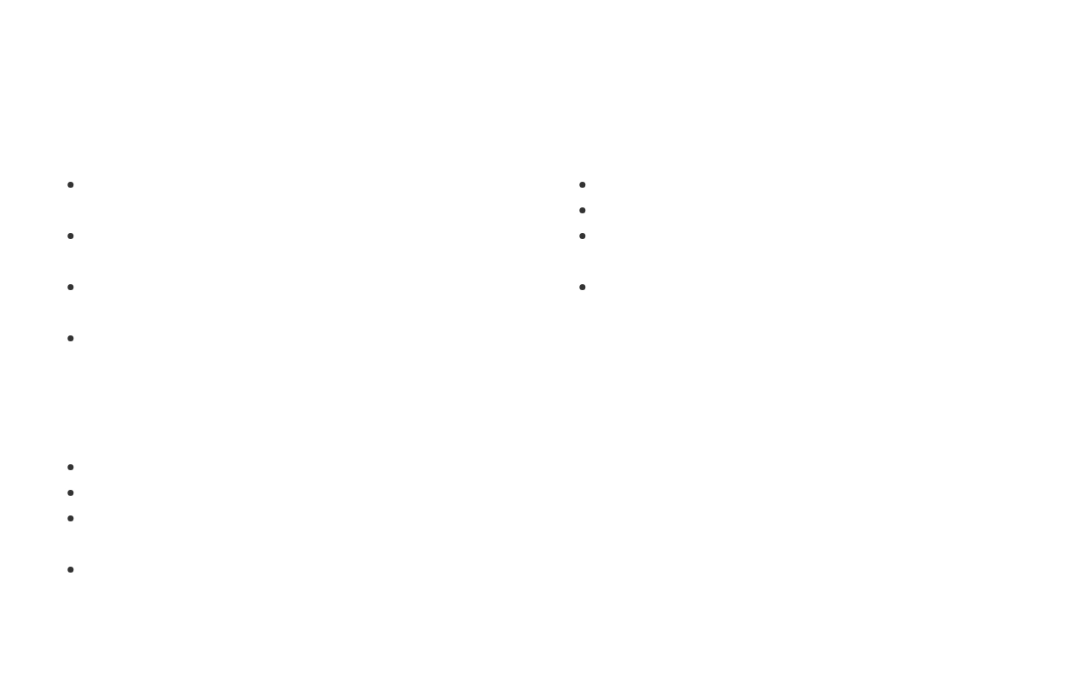


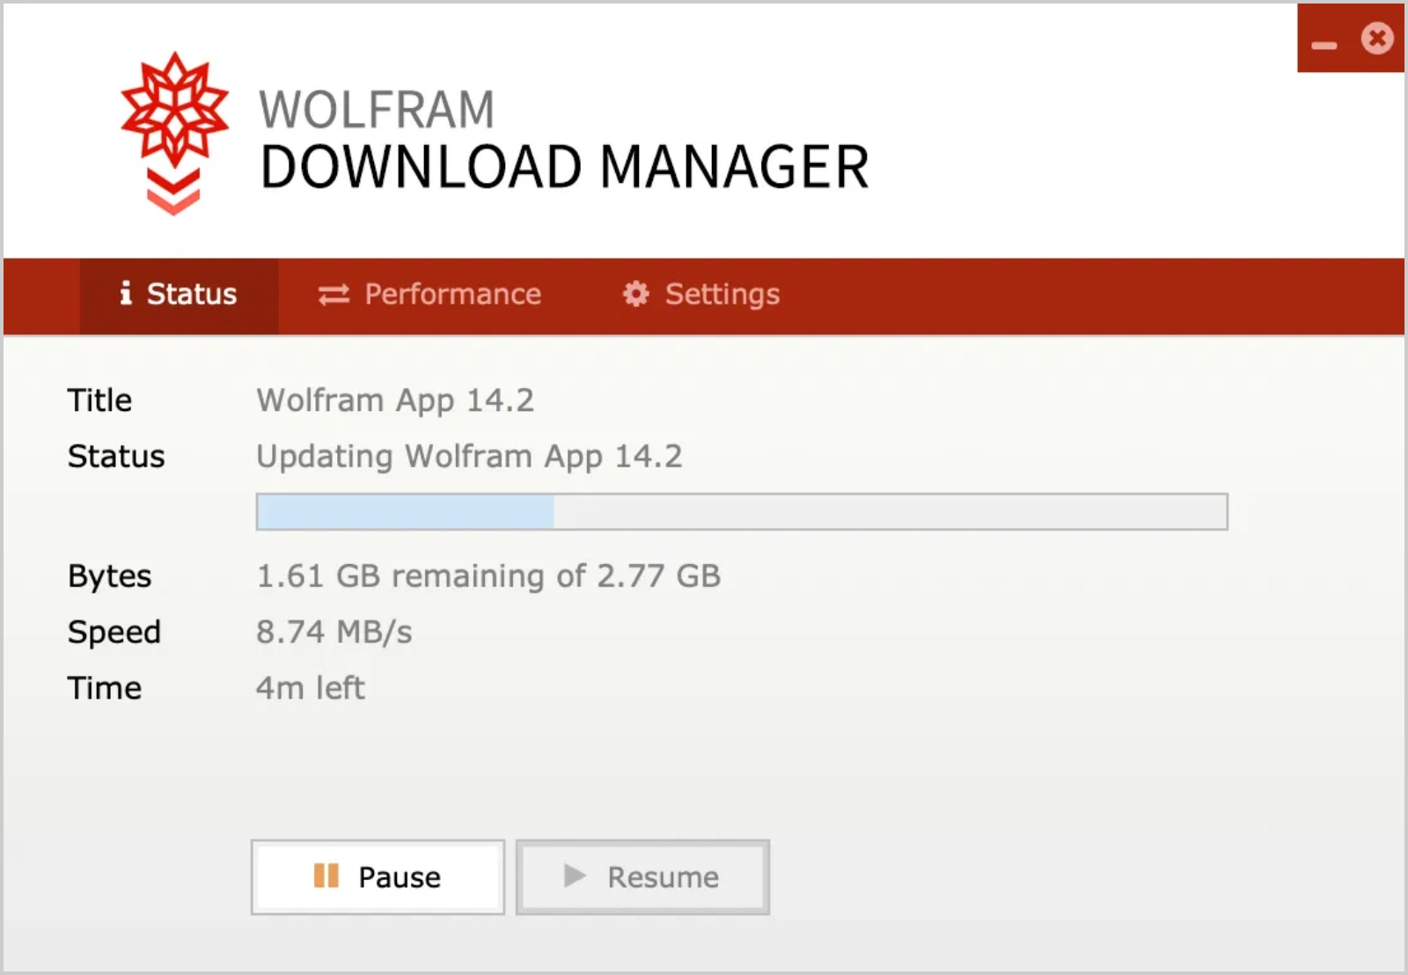

Troubleshooting & Support
Common Installation Issues
Additional Resources
Activation key not working
- Verify you're using the correct key and that it hasn't expired
Wolfram Support
- Official support portal
Wolfram Community
- User forums and discussions
Installation fails
- Ensure you have administrator privileges and sufficient disk space
Fast Introduction for Programmers
- Quick start guide
Cannot sign in
- Verify your Wolfram ID and password are correct
Elementary Introduction
- Beginner's guide to Wolfram Language
License not recognized
- Contact your instructor for validation status
Where to Get Help
Course instructor
- For license validation issues
University IT support
- For installation assistance
Wolfram Support
- For technical issues with the software
Wolfram Community
- For usage questions and peer assistance
10

